Slide 1
ESnet Science DMZ & Pilot Efforts
Energy Sciences Network (ESnet)
Lawrence Berkeley National Laboratory
Jason Zurawski – zurawski@es.net
Hackathon
February 28th, 2017

Slide 2
Outline
ESnet Overview
Why is Networking Hard?
Efficiently Moving Bits (e.g. the ‘Science DMZ’)
Pilot @ APS’s GM/CA
Open Call

Slide 3
ESnet Background
ESnet is a special-purpose mission network, funded by the US Congress to support scientific goals of the Department of Energy.
We see networking as a means to an end: scientific productivity.
We aim to create a world in which discovery is unconstrained by geography.

Slide 4
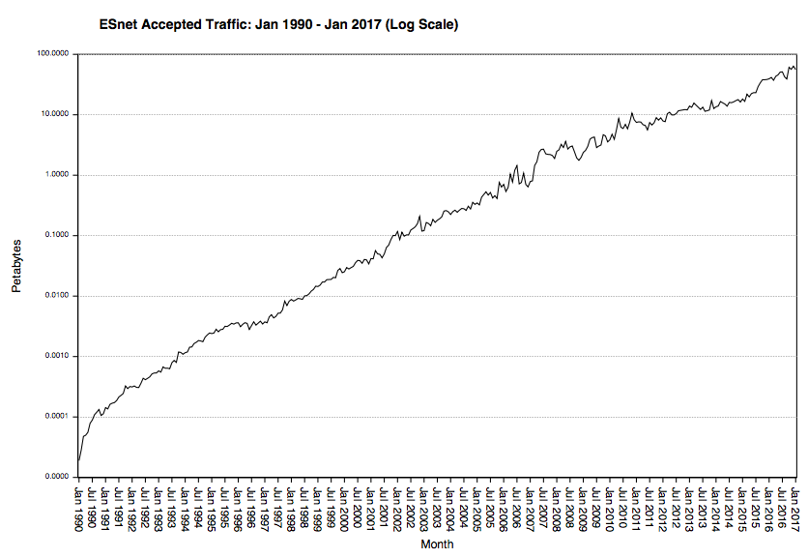
56 PB in Jan 2017
This is just R&E related traffic (e.g. not combined with commodity peering)

Slide 5
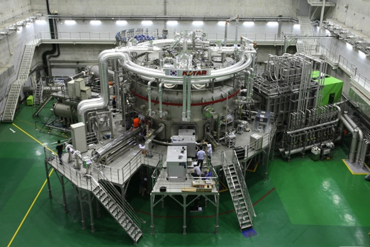
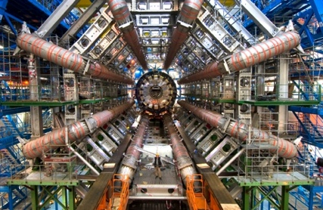
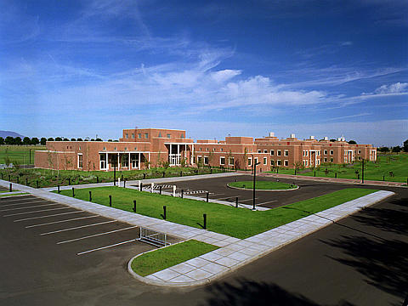
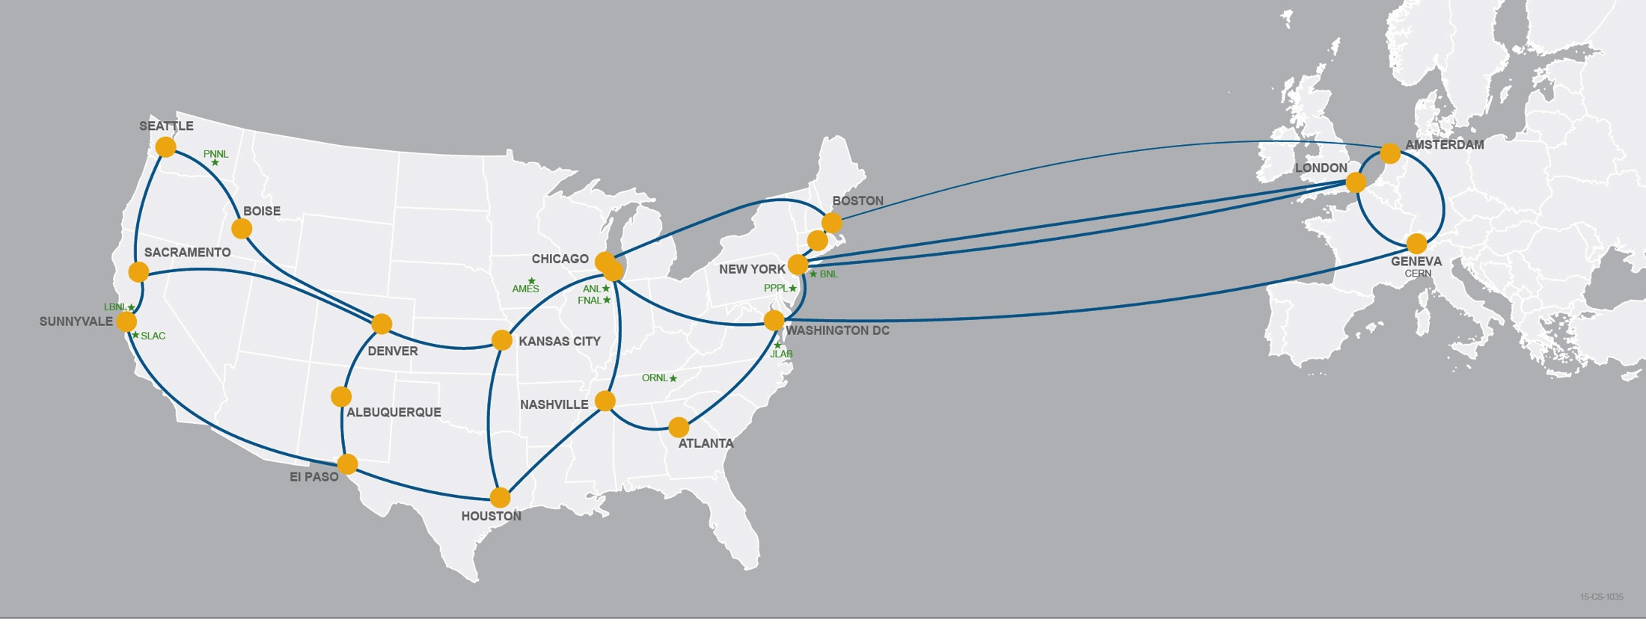
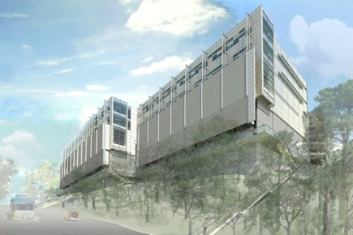
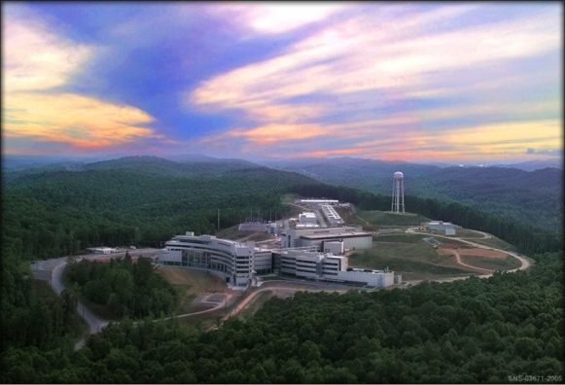
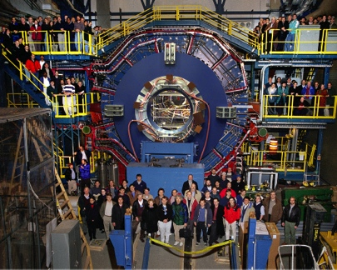
Network as Infrastructure Instrument
Connectivity is the first step – usability must follow

Slide 6
80% of ESnet traffic originates or terminates outside the DOE complex.
ESnet’s success is necessary but not sufficient for DOE, because networks share fate. SC invests nearly $1B/year in university research: campus networks matter.

Slide 7
Outline
ESnet Overview
Why is Networking Hard?
Efficiently Moving Bits (e.g. the ‘Science DMZ’)
Pilot @ APS’s GM/CA
Open Call

Slide 8
Motivation
Networks are an essential part of data-intensive science
Connect data sources to data analysis
Connect collaborators to each other
Enable machine-consumable interfaces to data and analysis resources (e.g. portals), automation, scale
Performance is critical
Exponential data growth
Constant human factors
Data movement and data analysis must keep up
Effective use of wide area (long-haul) networks by scientists has historically been difficult
Notes:
Human factors – attention span, ability to manage complexity – these are constant
There is a huge amount of promise in data-intensive science. Effective use of networks can help realize those benefits.
The Science DMZ model helps address the difficulties scientists often experience with using networks.

Slide 9
TCP – Ubiquitous and Fragile
Networks provide connectivity between hosts – how do hosts see the network?
From an application’s perspective, the interface to “the other end” is a socket
Communication is between applications – mostly over TCP
TCP – the fragile workhorse
TCP is (for very good reasons) timid – packet loss is interpreted as congestion
Packet loss in conjunction with latency is a performance killer
Like it or not, TCP is used for the vast majority of data transfer applications (more than 95% of ESnet traffic is TCP)
Notes:
The application sees the network as a socket.
The socket interface does not provide path diagnostics or other troubleshooting information.
TCP behaves as it does because of measures taken in the 1980s to fix the congestion collapse of the Internet
TCP makes a promise to the application – TCP will get the data to the other end, or TCP will return an error. TCP makes no promises about performance.

Slide 10
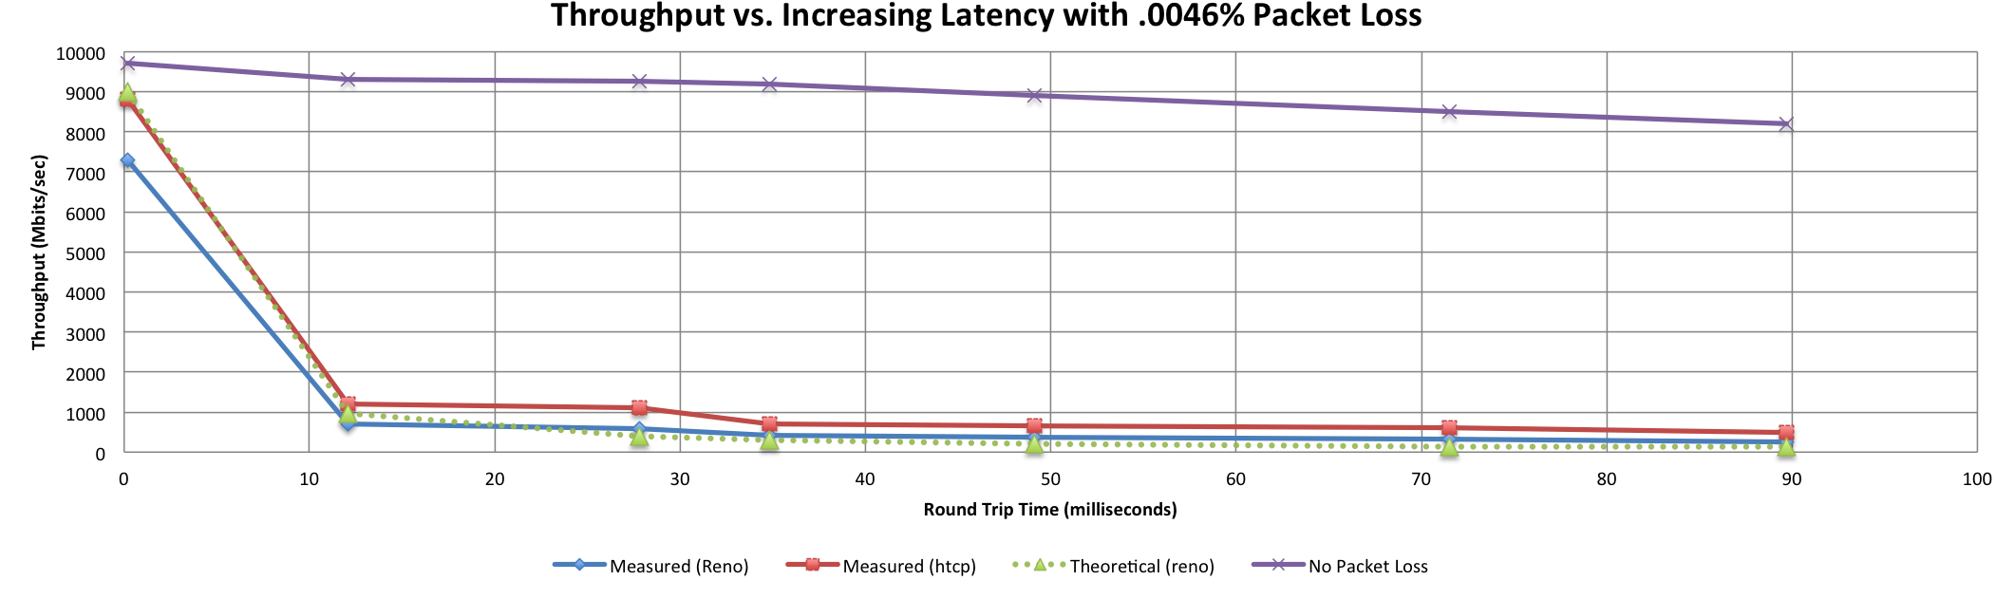
A small amount of packet loss makes a huge difference in TCP performance
With loss, high performance beyond metro distances is essentially impossible
Local
(LAN)
International
Metro Area
Regional
Continental
Measured (TCP Reno)
Measured (HTCP)
Theoretical (TCP Reno)
Measured (no loss)
Notes:
This is an annotated version of the plot from the Science DMZ paper
Beyond your metro area, zero loss is essentially required for high performance
Where are your collaborators? Where are your users?
When global collaboration is the norm, nobody can afford to be a local-only resource

Slide 11
Working With TCP In Practice
Far easier to support TCP than to fix TCP
People have been trying to fix TCP for years – limited success
Like it or not we’re stuck with TCP in the general case
Pragmatically speaking, we must accommodate TCP
Sufficient bandwidth to avoid congestion
Zero packet loss
Verifiable infrastructure
Networks are complex
Must be able to locate problems quickly
Small footprint is a huge win – small number of devices so that problem isolation is tractable
Notes:
Do not underestimate the value of three TCP improvements:
RFC1323 (window scaling)
Kernel autotuning
Improved congestion algorithms
However, loss + latency is still a performance killer.
TCP must be accommodated – this is our job as engineers and architects

Slide 12
Outline
ESnet Overview
Why is Networking Hard?
Efficiently Moving Bits (e.g. the ‘Science DMZ’)
Pilot @ APS’s GM/CA
Open Call

Slide 13
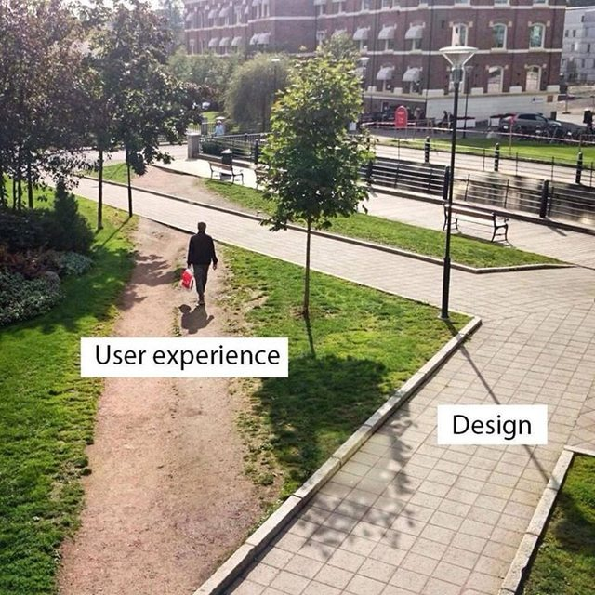
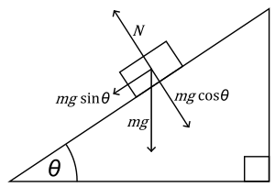


The Science DMZ in 1 Slide
Consists of three key components, all required:
“Friction free” network path
Highly capable network devices (wire-speed, deep queues)
Virtual circuit connectivity option
Security policy and enforcement specific to science workflows
Located at or near site perimeter if possible
Dedicated, high-performance Data Transfer Nodes (DTNs)
Hardware, operating system, libraries all optimized for transfer
Includes optimized data transfer tools such as Globus Online and GridFTP
Performance measurement/test node
perfSONAR
Engagement with end users
Details at http://fasterdata.es.net/science-dmz/
© 2013 Wikipedia
Notes:
Single slide summary

Slide 14
Local And Wide Area Data Flows
Notes:
The green data path is susceptible to TCP performance problems stemming from packet loss combined with long distances
The red data path is very low latency – loss matters much less here (though too much loss will still cause problems)
Remember the throughput vs. latency graph

Slide 15
Dedicated Systems – Data Transfer Node
The DTN is dedicated to data transfer
Set up specifically for high-performance data movement
System internals (BIOS, firmware, interrupts, etc.)
Network stack
Storage (global filesystem, Fibrechannel, local RAID, etc.)
High performance tools
No extraneous software
Limitation of scope and function is powerful
No conflicts with configuration for other tasks
Small application set makes cybersecurity easier
Notes:
All aspects of the DTN must be tuned – even the BIOS matters
Limit the scope of the DTN as well – its job is data movement, its job is not to have office software on it.
Craft a specific security profile/policy around its only task.

Slide 16
Data Transfer Tool Comparison
In addition to the network, using the right data transfer tool is critical
Data transfer test from Berkeley, CA to Argonne, IL (near Chicago). RTT = 53 ms, network capacity = 10Gbps.
Tool Throughput
scp: 140 Mbps
HPN patched scp: 1.2 Gbps
ftp 1.4 Gbps
GridFTP, 4 streams 5.4 Gbps
GridFTP, 8 streams 6.6 Gbps
Note that to get more than 1 Gbps (125 MB/s) disk to disk requires properly engineered storage (RAID, parallel filesystem, etc.)
Notes:
Comparison of legacy and recommended tools.
Note that rsync over HPN-SSH is reasonable in a 1Gbps environment – if you are stuck with rsync over SSH, at least use HPN-SSH.
Globus is now deployed at a large number of major scientific sites – the basic data transfer functionality is free.

Slide 17
Outline
ESnet Overview
Why is Networking Hard?
Efficiently Moving Bits (e.g. the ‘Science DMZ’)
Pilot @ APS’s GM/CA
Open Call

Slide 18
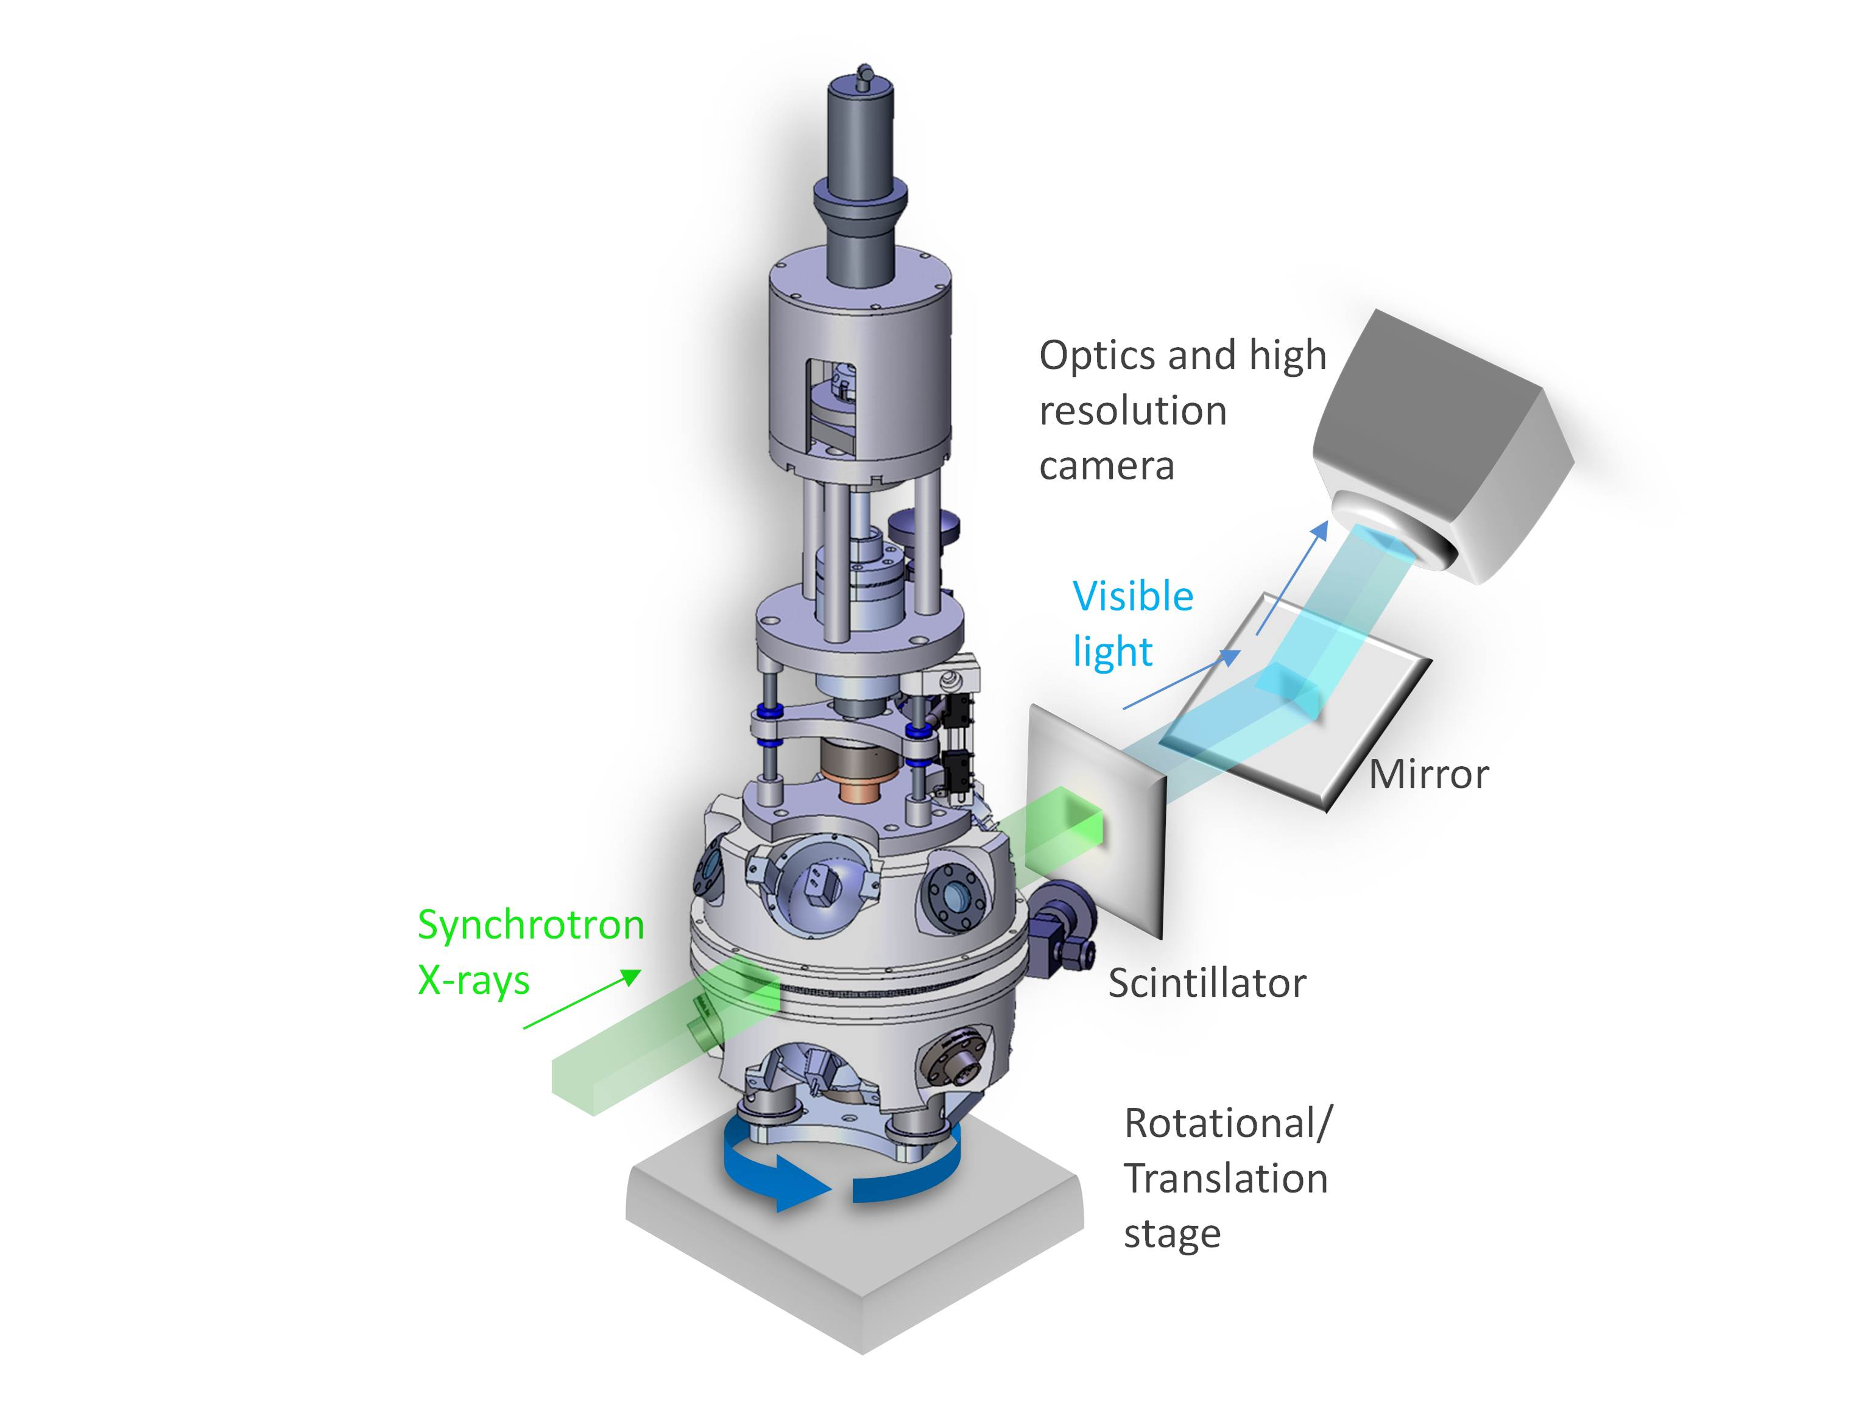
GM/CA
General Medical Sciences and Cancer Institutes Structural Biology Facility @ APS
Focused on the study of crystallographic structure determination of biological macromolecules by X-ray diffraction
Typical User:
Visits and spends some allocated time with samples and the beamline machinery
Mails samples, controls device remotely
In either case – data has to go ‘somewhere’

Slide 19
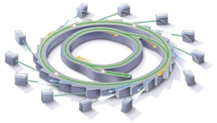
Superfacility instances multiply.
By 2025, DOE light sources will be transformed by high-resolution detectors, advanced mathematical analysis techniques, robotics, software automation, programmable networks.
Integration of experimental and computational facilities in real time, using programmable networks.
Detectors capable of generating terabit data streams.
Computational tools for analysis, data reduction, feature extraction in situ, using advanced algorithms and specialized hardware.
Data management and sharing, with federated identity management and flexible access control.
Increased scientific throughput from robotics and automation software.
Post-processing: reconstruction, inter-comparison, simulation, visualization.

Slide 20
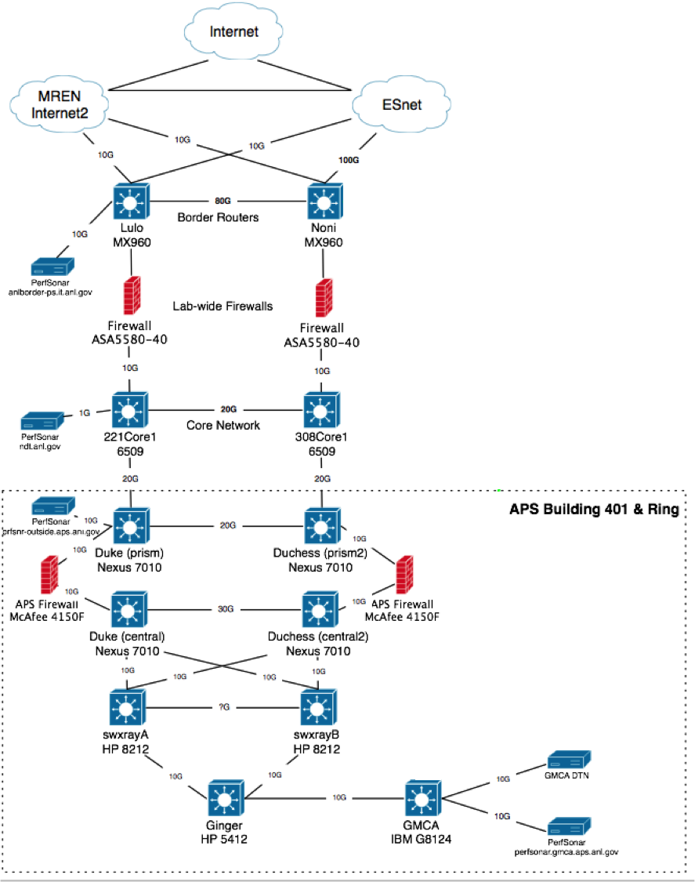
Current Design

Slide 21
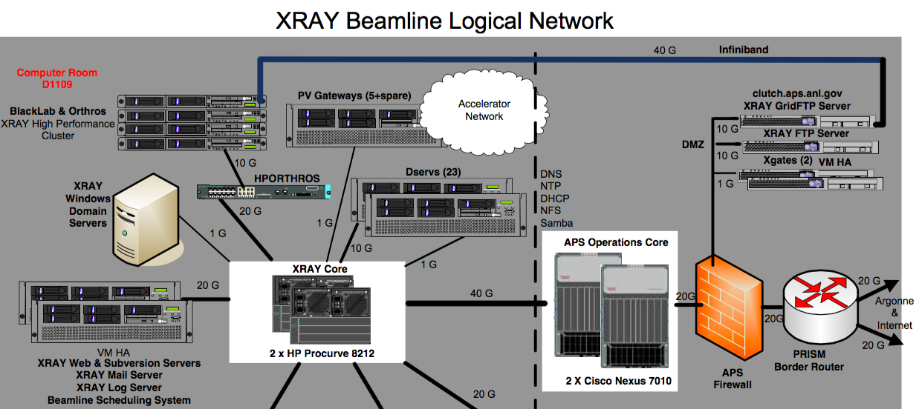
Current Design

Slide 22
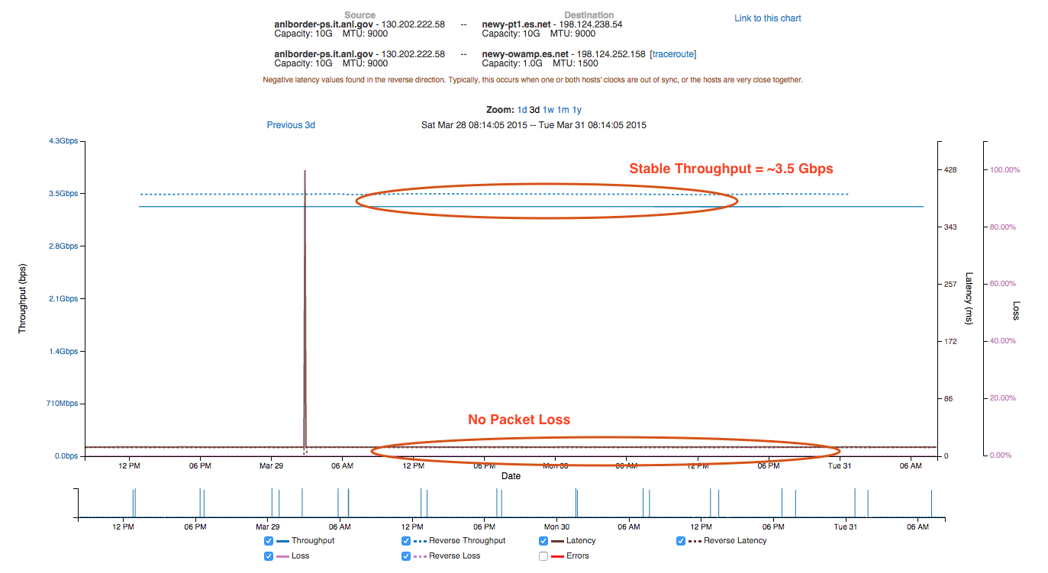
ANL Border to ESnet New York (perfSONAR Test)

Slide 23
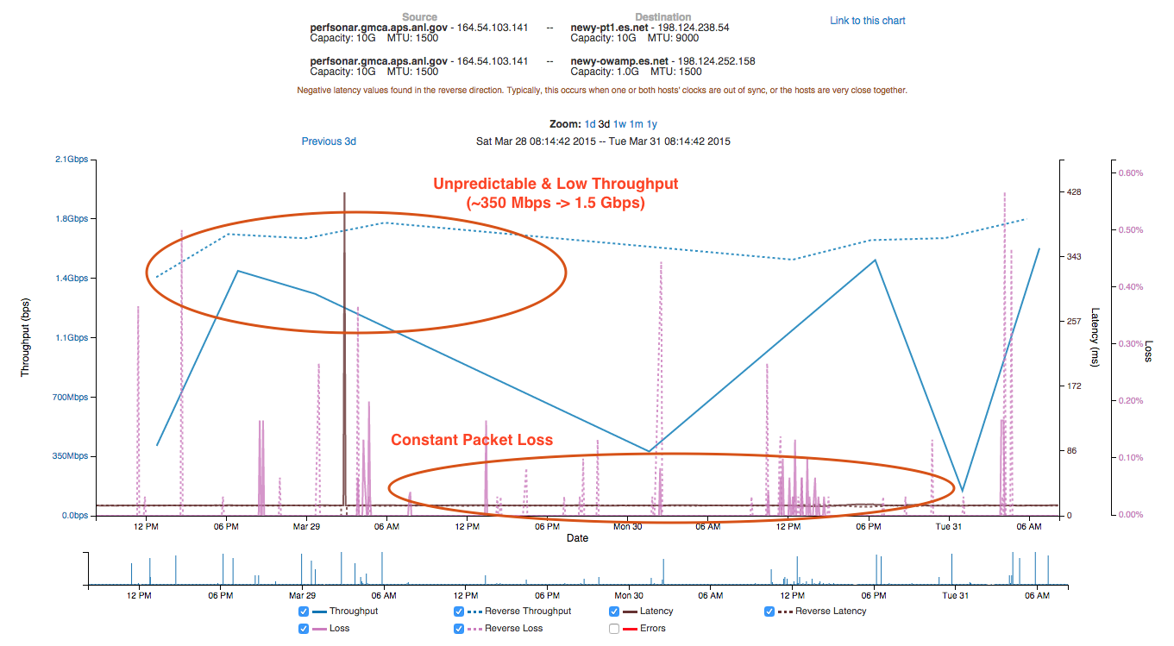
GM/CA to ESnet New York (perfSONAR Test)

Slide 24
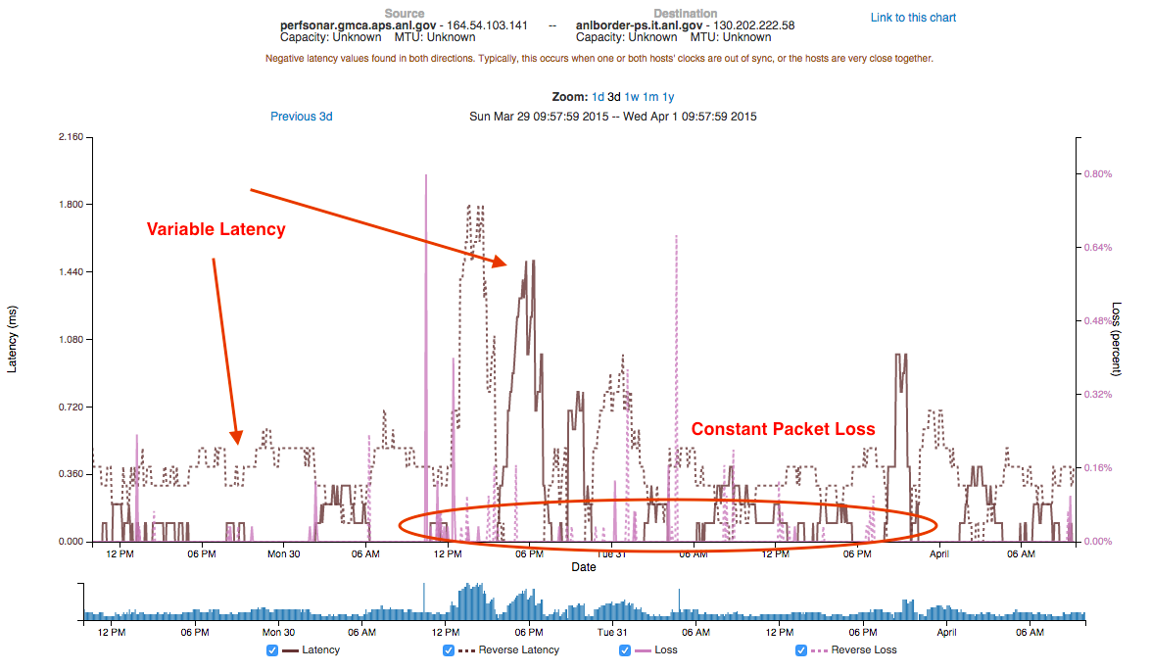
GM/CA to ANL Border (perfSONAR Test)

Slide 25
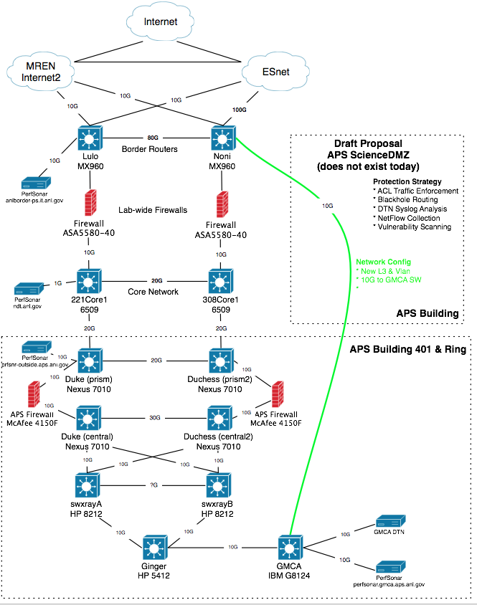
Pilot Network
Plan:
Use campus and building fiber resources for 2nd path
Applies to only a limited set of resources (perfSONAR, DTN)
Benefits
Bypass congested local infrastructure
Apply targeted (vs. blanket) security policy
Cautions:
Prevent just ‘anything’ from using fast path – policy to control this
Still need to figure out cause of local issues (e.g. this isn’t a pave over)

Slide 26
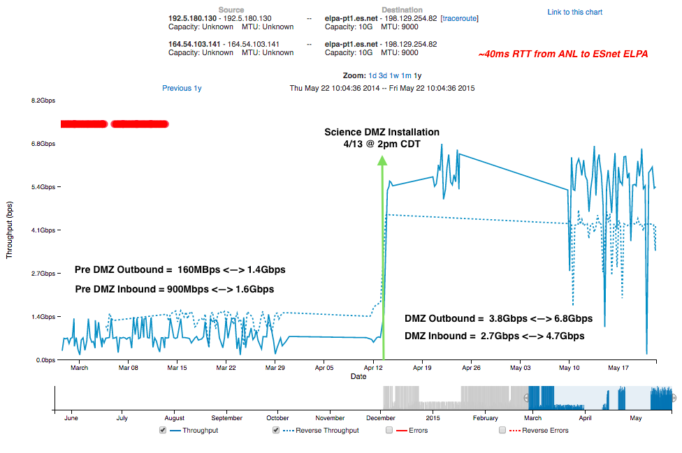
perfSONAR Results

Slide 27
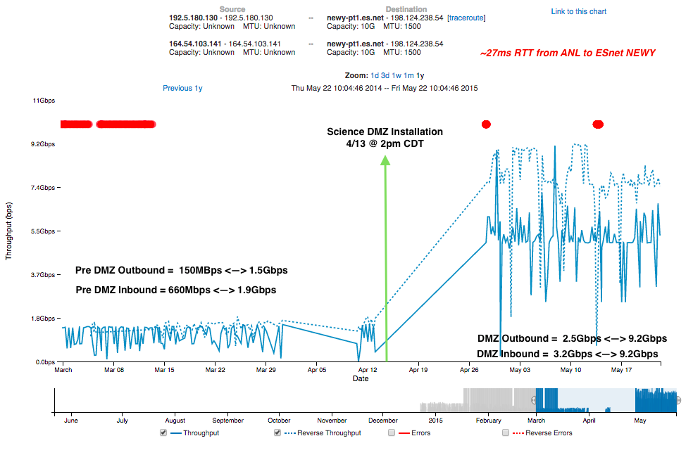
perfSONAR Results

Slide 28
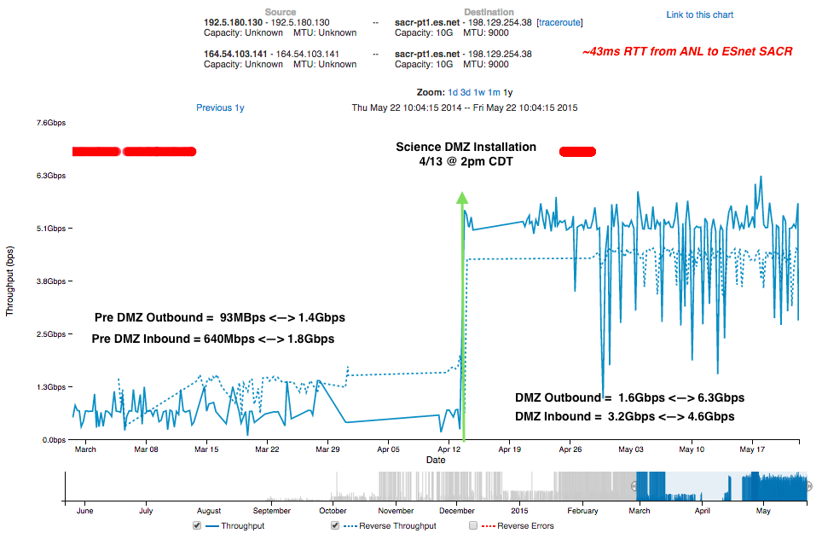
perfSONAR Results

Slide 29
perfSONAR is One Metric – what about GridFTP?
Setup of the DTN Architecture:
2 Servers
Shared filesystem
Each server has 2 interfaces/routes:
Science DMZ routes (plumbed to specific external locations via ANL, ESnet/MREN) and avoiding slower path
Traditional routes over slower path
Goal: show that with the correct network the *SAME* underlying infrastructure can perform as well as the perfSONAR testing

Slide 30
Testing ESnet CERN (long RTT) to GMCA
Scale is Mbps
Across the board improvement of around 5x-20x
Exercise helped to tune filesystem performance.

Slide 31
Testing GMCA to ESnet CERN (long RTT)
Metadata operations (e.g. deeply nested directories) coupled with smaller files remains hard to crank up

Slide 32
Testing GMCA to ESnet LBL (medium RTT)
Metadata operations (e.g. deeply nested directories) coupled with smaller files remains hard to crank up

Slide 33
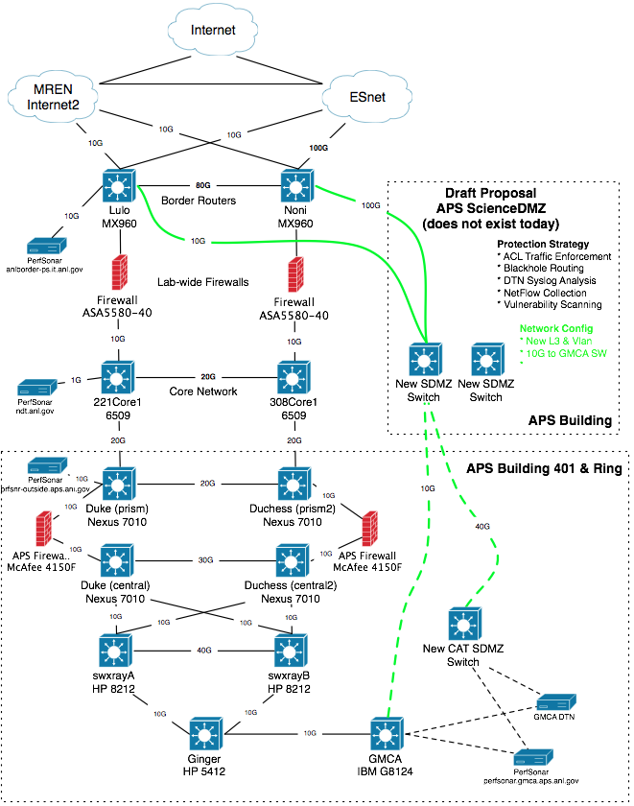
Future
Wider use @ APS
Solution now goes directly to a specific beamline – how to support the entire facility?
Wider use @ ANL
Service for other research groups (e.g. ALCF, ARM, etc.)
Pool of DTN resources w/ Globus, instead of each group manning their own (allows to back up to communal storage)
Defining Policy
ACLs – ports exposed for things like perfSONAR, Globus. Shut off for things that don’t need it. Gray area is defining what is and is not science.
Who gets on, who doesn’t
Managing routing @ the border to best utilize the available WAN links

Slide 34
APS Science DMZ Pilot
What about to user networks? Trial tests to (excited) Universities:
Stanford: Installed a dedicated ‘Science DMZ’ connection in the APS user’s lab at Stanford (bypasses institutional firewalls)
Purdue: Worked well … since they already had a Science DMZ ☺
Rice: Seeking NSF and institutional funding (and using the APS user as a pilot) to install a campus-wide Science DMZ
Trial test to (less excited) Universities:
Michigan: Acknowledged internal network issues, expected resolution is mid 2017.
Minnesota: Was not able to provide updated test data.
USC: Was not able to provide updated test data.
Takeaways: Building a DMZ at a Lab/Facility is only the first step. We all share fate when it comes to scientific data movement, and improving outcomes at universities ‘raises all boats’.

Slide 35
Outline
ESnet Overview
Why is Networking Hard?
Efficiently Moving Bits (e.g. the ‘Science DMZ’)
Pilot @ APS’s GM/CA
Open Call

Slide 36
Science Engagement Vision – Revisited
Building on the success of Science DMZ, work with collaborators and partners at DOE, DOE labs, academia and industry to imagine a new standardized “service” or architecture model that would greatly simplify the methods for scientists to access, analyze, move and store data without IT intervention or ad hoc engineering heroics.
This means working together to move many “prototype” workflow and portal technologies into production.

Slide 37
Extending the Idea of the APS Pilot
Other Beamlines?
Other Labs?
engage@es.net

Slide 38
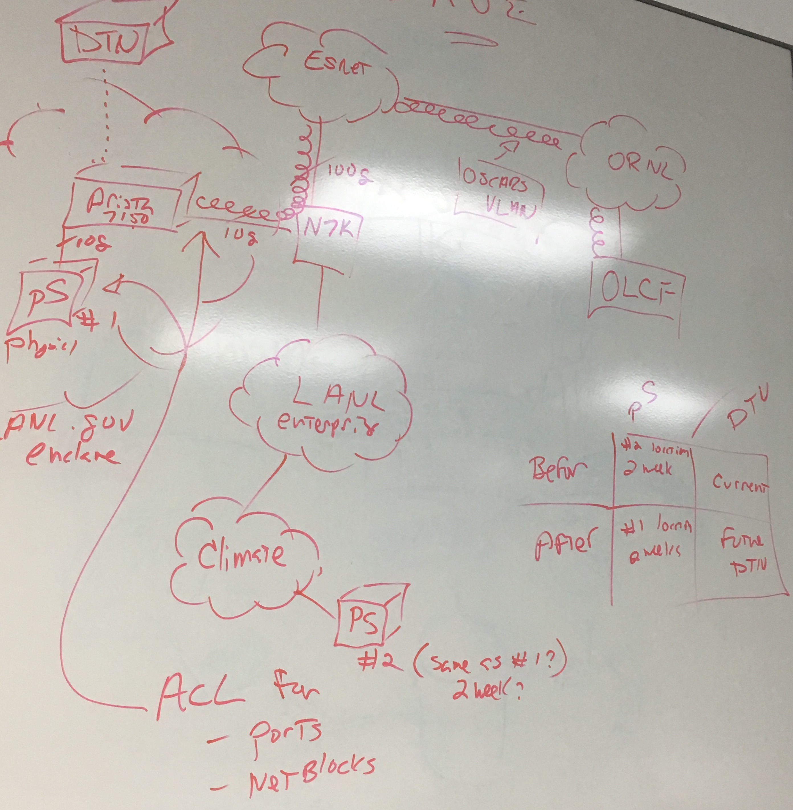
LANL Example - Putting Theory into Practice
Discussion:
Security of the enclave
perfSONAR Testing Strategies
Locating a scientific user
Identifying traffic patterns over ESnet to other DOE sites
Use of OSCARS
Appropriate hardware for the network layer

Slide 39
LANL Testimonial
Heightened ESnet awareness generating questions like:
Who is our ESnet representative?
What it the ESnet SLA?
Stimulated inter-organization communication on network design
This is his indicator of workshop success
Met to review plans for diverse fiber path and backup ESnet connection
Identified special needs for gene sequencers
“perfSONAR keeps coming up in hallway conversations. The discussions range from testing new designs to before-and-after measurement to diagnosing problems in today's production network.”
“The workshop was well received from everyone I talked to. We have a better, shared understanding on how to support science”

Slide 40
ESnet Science DMZ & Pilot Efforts
Energy Sciences Network (ESnet)
Lawrence Berkeley National Laboratory
Jason Zurawski – zurawski@es.net
Hackathon
February 28th, 2017

